Slide 1
Machine Learning In Energy Industry
Apply Machine Learning To Renewable Energy

Slide 2
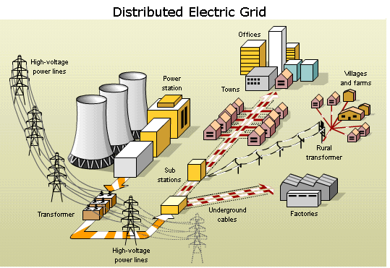
Distributed Electric Grid:
What is a power grid?
-An interconnected network for delivery electricity from producers to consumers
-Consists of generating station that generates power and transports it using transmission line

Slide 3

Supply vs Demand
Homes and Businesses account for nearly 40% of U.S. energy consumption.
Homes
And
Business
Factories
POWER GRID
DATA
BASE
CENTER

Slide 4
Problems with Renewable Energy?
Supply
-depends heavily on weather
-can be dip too low or soar too high
Transport
-located far from the cities and factories.
-needs high-voltage power lines to transport electricity

Slide 5
Solutions:
Giant Storage Battery
Pros:
-cleaner energy
-cost effective in long run
Cons:
-Battery disposal waste
-Still produces for making battery
AI Forecast Response
Pros:
-reducing CO2 emissions
-cleaner energy
-cost effective in long run
Cons:
-expensive upfront investments
-still relies on many factors

Slide 6
Chasing the wind
A few years ago:
-Xcel Energy’s old AI model was usually 20% off, and sometimes wind power’s prediction failed completely.
-Relied on backup fossil-fuel plants idling, ready to replace all of that wind power in a few minutes
Cons:
-Expensive to maintain idling plants.
-non-reliable

Slide 7
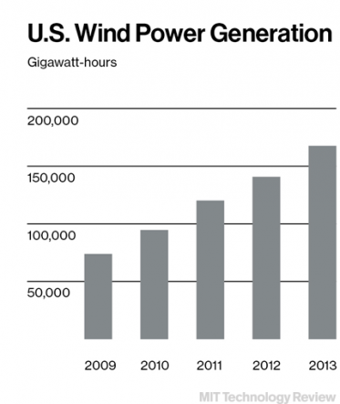
How AI can help?
How:
-The new AI-based softwares analyzes data from weather satellites, weather stations of NCAR.
Result:
The amount of wind has more than doubled since 2009

Slide 8
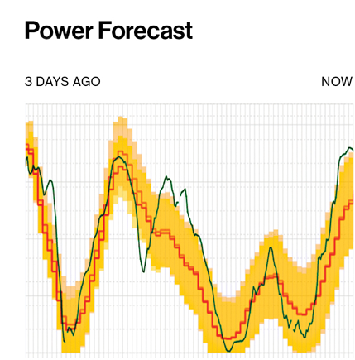
How AI can help?
How:
-If the weather is cold and wet, factories switch to fossil-fuel backup.
-On abundant wind day, factories shut down many of the idling backup plants.
Result:
-Power supply matches demand
-Green: Actual power output, red: forecast
-The larger the yellow area, the more uncertainty the forecast

Slide 9
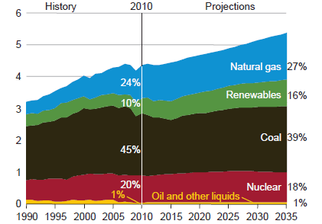
Future Prediction
Renewable energy
will increase to 16%
by 2035
Investment into
renewable energy
will heavily increase
Source: NREL Lab

Slide 10
Citations:
[1] Bullis, Kevin. “Smart Wind and Solar Power.” Page 1-15. November 12 2016.Web. < https://www.technologyreview.com/s/526541/smart-wind-and-solar-power/>
[2]Todd, Jaquith. “How Future Energy Will Change Our Lives.” January 9, 2017. Web. <https://futurism.com/predicting-2017-how-future-energy-will-change-our-lives/>
[3]Statoil, Boye. “Why The World Isn’t Ready For Renewable Energy”. Jan 21, 2015. Web. <https://www.forbes.com/sites/statoil/2015/01/21/why-the-world-isnt-ready-for-renewable-energy-and-how-we-can-be/#37abe438687e>
[4]O’Connor, Mary. “How Artificial Intelligence Is Making Energy Smarter and Cleaner”. July 18 2016. Web. <https://medium.com/s/ai-for-good/how-artificial-intelligence-is-making-energy-smarter-and-cleaner-75688867f25e>
[5]Burston, Jane. “Predictions For Energy In 2030”. Nov 10 2016. Web. <https://www.weforum.org/agenda/2016/11/5-predictions-for-energy-in-2030/>

